Slide 1
Economy Outlook in Three Categorizations
National Economy, personal Finances, and Inequality
Yehui He

Slide 2
Overview
National Level
Gloomy economic context
Dissatisfaction with the economy
Personal Finances
Personal finances better than national economy
Inequality
Next generation

Slide 3
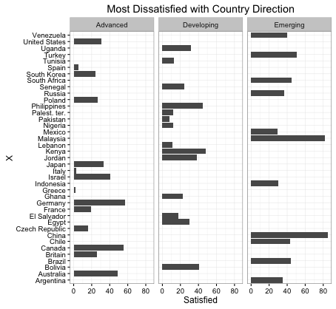
National and Economic Conditions

Slide 4
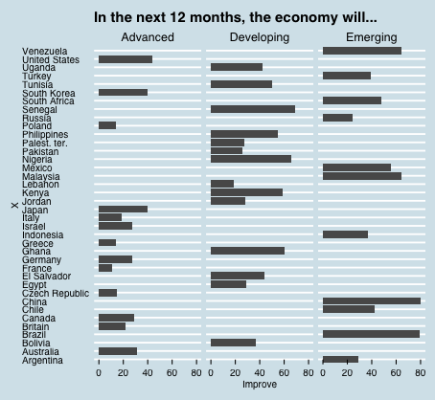
Little Hope for the Coming Year

Slide 5
Observation of National Economy
Across the globe, few are happy with the direction of their country – less than half in 34 of the 39 countries surveyed say things are going well. Satisfaction is particularly low in advanced and developing economies, while publics in emerging markets tend to be somewhat more content.
In addition to publics’ relatively grim assessment of current conditions, many across the globe are skeptical that things will improve over the next 12 months. Fewer than half in 28 of the 39 countries surveyed expect the economy will get better in the next year.

Slide 6
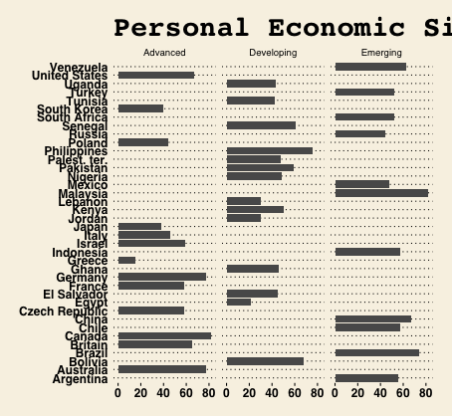
Personal Economic Conditions

Slide 7
Among wealthier nations, Canadians, Germans and Australians stand out as especially satisfied with their personal finances
In nine of the 11 emerging nations polled, more than half say their situation is good.
While personal assessments are generally less positive in developing nations, there are nonetheless several countries where solid majorities rate their personal economic circumstances favorably.

Slide 8
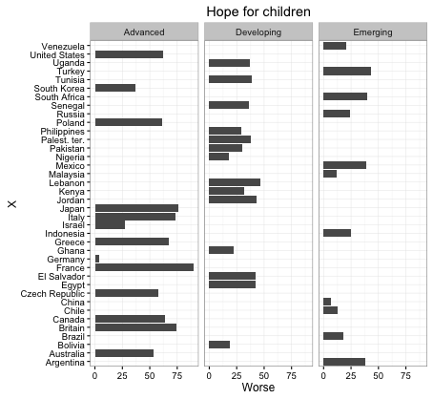
Next Generation

Slide 9
Nearly two-thirds of those surveyed in advanced economies think that children will be worse off when they grow up than their parents. Meanwhile, 58% of publics in emerging markets believe kids will be better off, as do 45% of those in developing economies.
There is particularly strong faith in economic mobility in China (82%), Brazil (79%), Chile (76%) and Malaysia (72%), all emerging markets that, with the exception of Brazil, have experienced relatively robust economic growth in recent years.
The single most pessimistic country by far about the economic fortunes of the next generation is France (90%), followed by Japan (76%).

